Slide 1
Data Analyst Jobs Project- presentation
Prepared by :- Sonu Thakur
Submitted To :- Unified mentor group

Slide 2
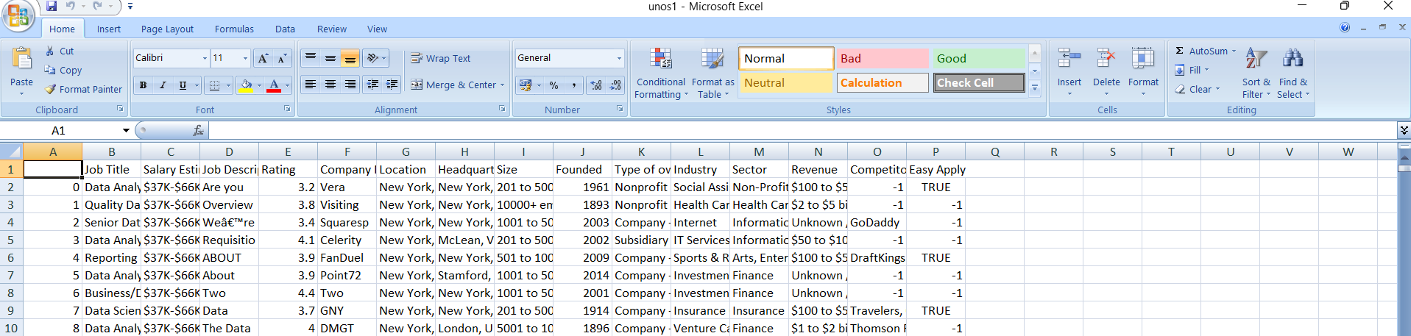
Project Overview :
Objective: Analyze job trends, salaries, and hiring patterns in the data analytics field. Dataset: Extracted from job portals (CSV format) Tools Used: Python (Pandas, Matplotlib), SQL (SQLite), Excel, Machine Learning
Dataset sample:-

Slide 3
Data Preprocessing & Cleaning
Key insight:-
✅ Handled missing values (filled NAs, removed nulls) ✅ Parsed salary data (converted to numerical values) ✅ Standardized column names and formats ✅ Removed duplicate entries
Data cleaning code :

Slide 4
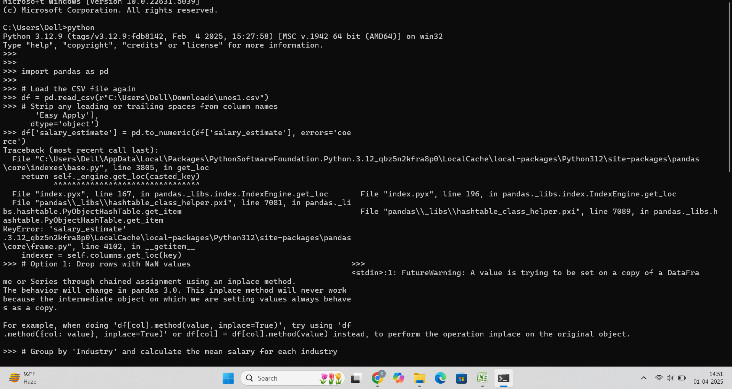

Slide 5
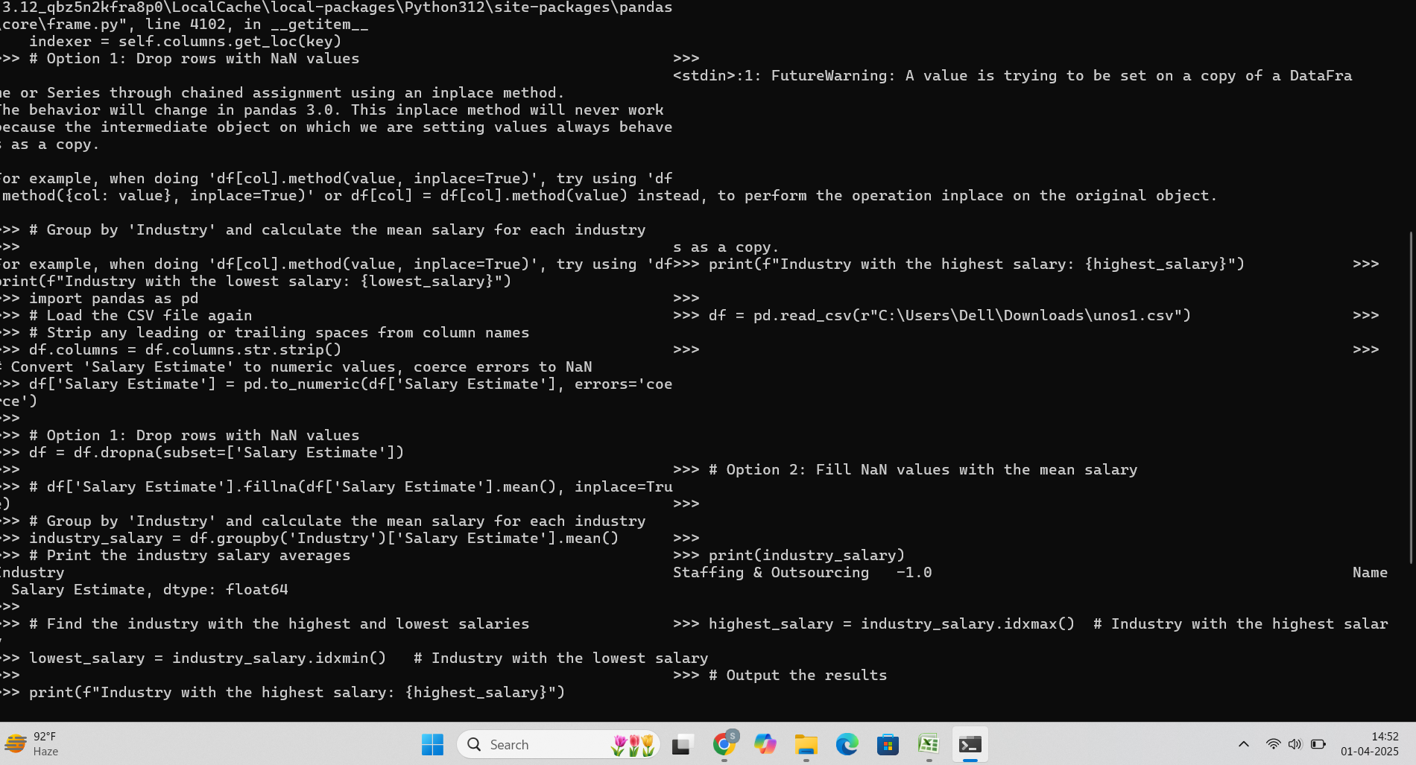

Slide 6
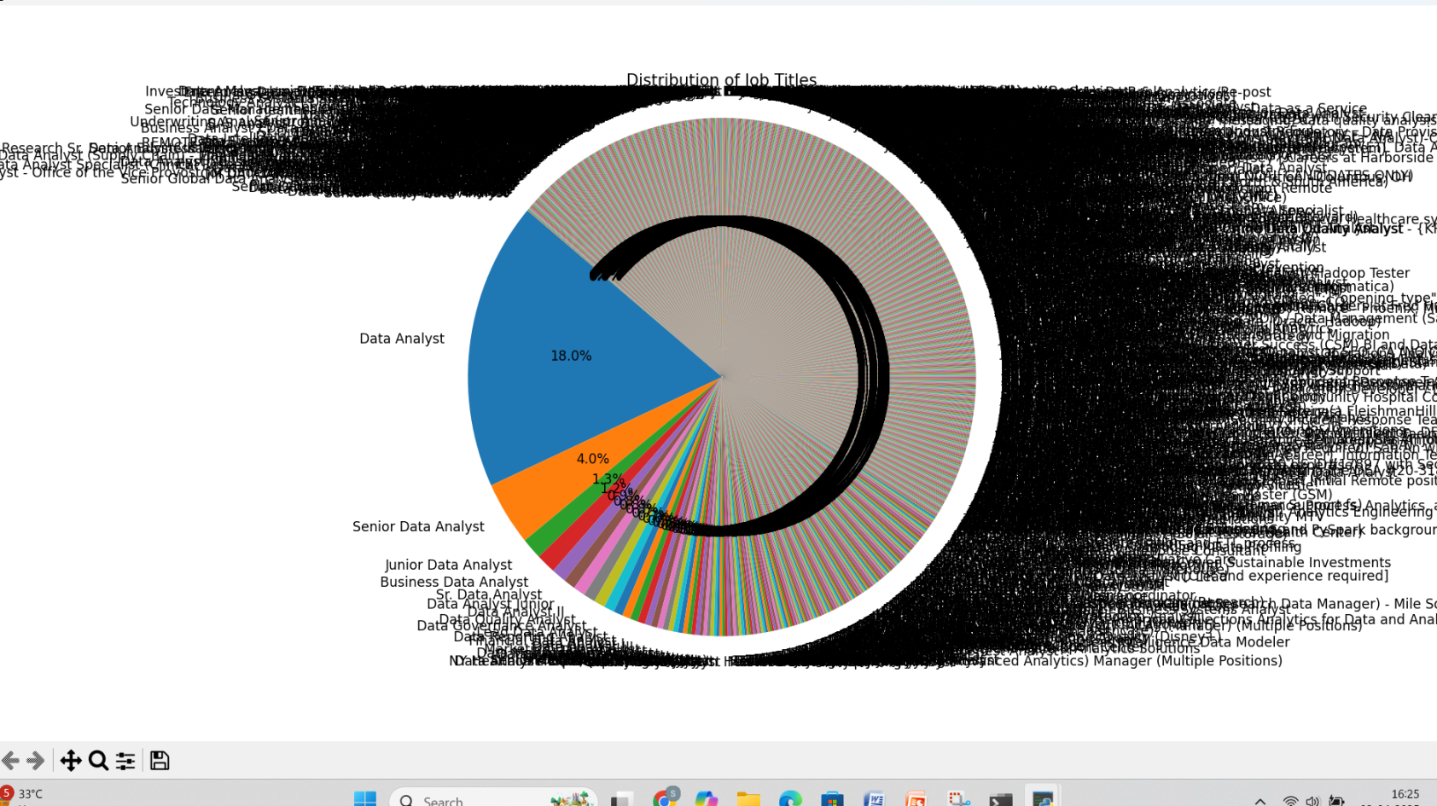
Exploratory Data Analysis (EDA)
📊 Key Insights: ✅ Pie chart of job titles distribution

Slide 7
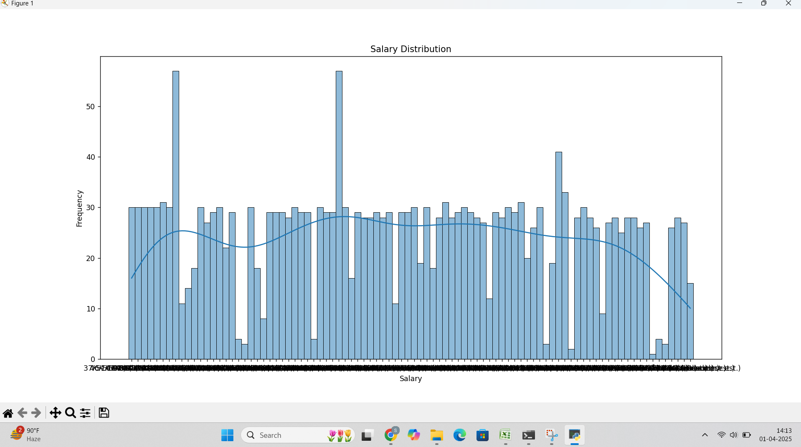
salary distribution

Slide 8
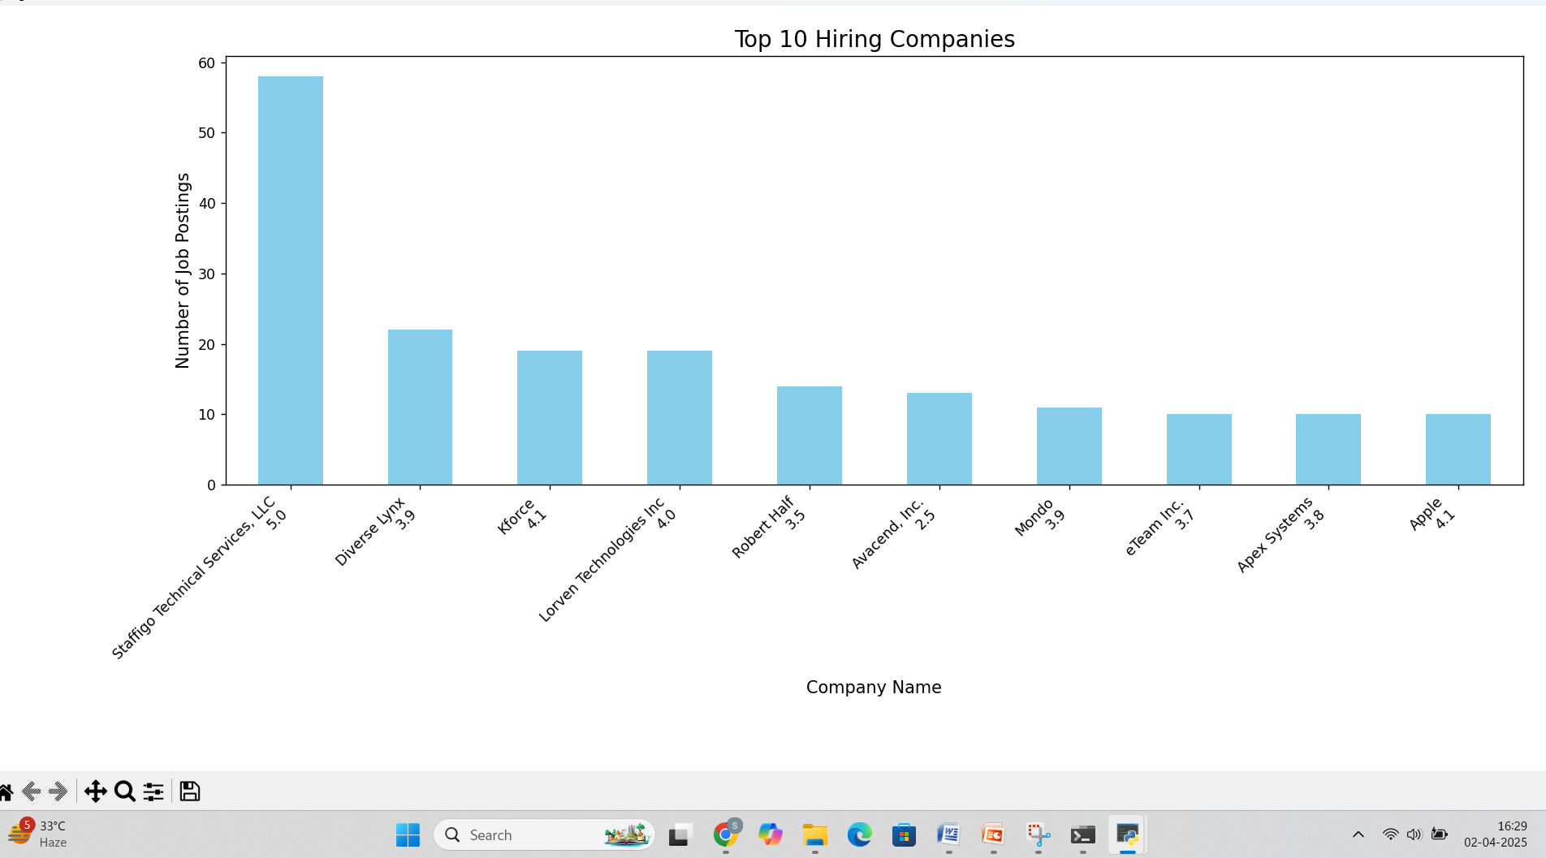
Bar graph of top 10 hiring companies

Slide 9
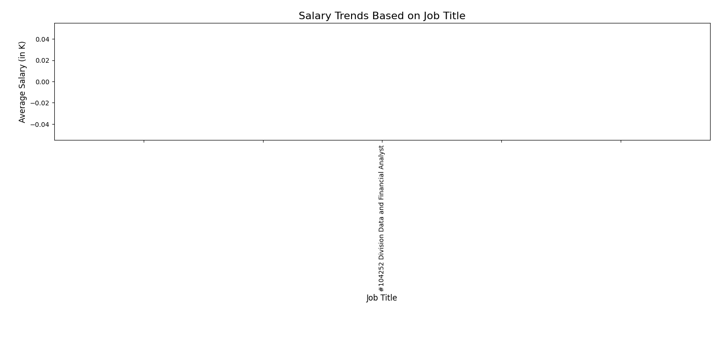
Data Visualizations
✅ Salary trends based on job title

Slide 10
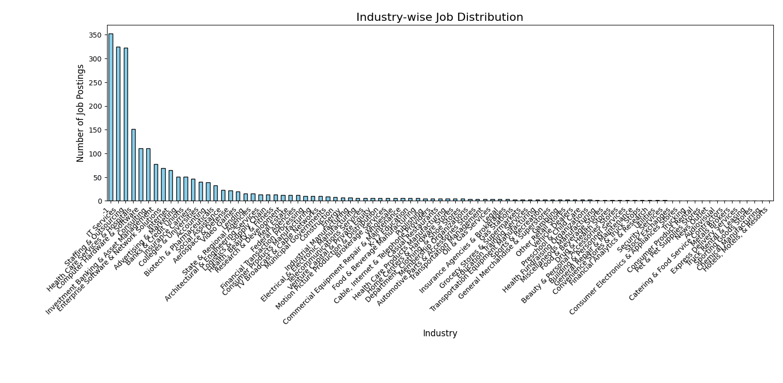
✅ Industry-wise job distribution

Slide 11
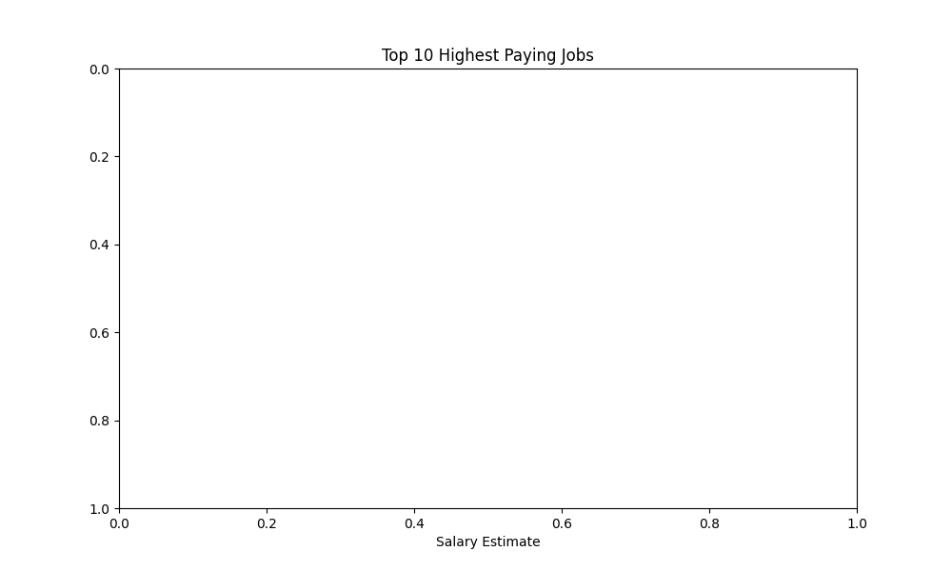
Visualizing Top 10 Highest-Paying Jobs

Slide 12
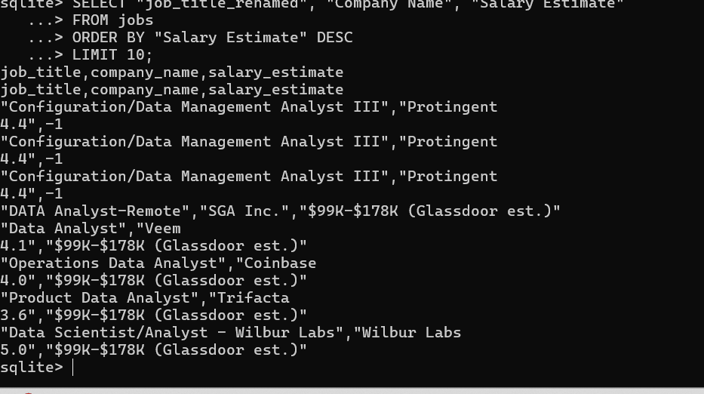
SQL Queries for Deeper Analysis
✅ Find highest-paying jobs

Slide 13
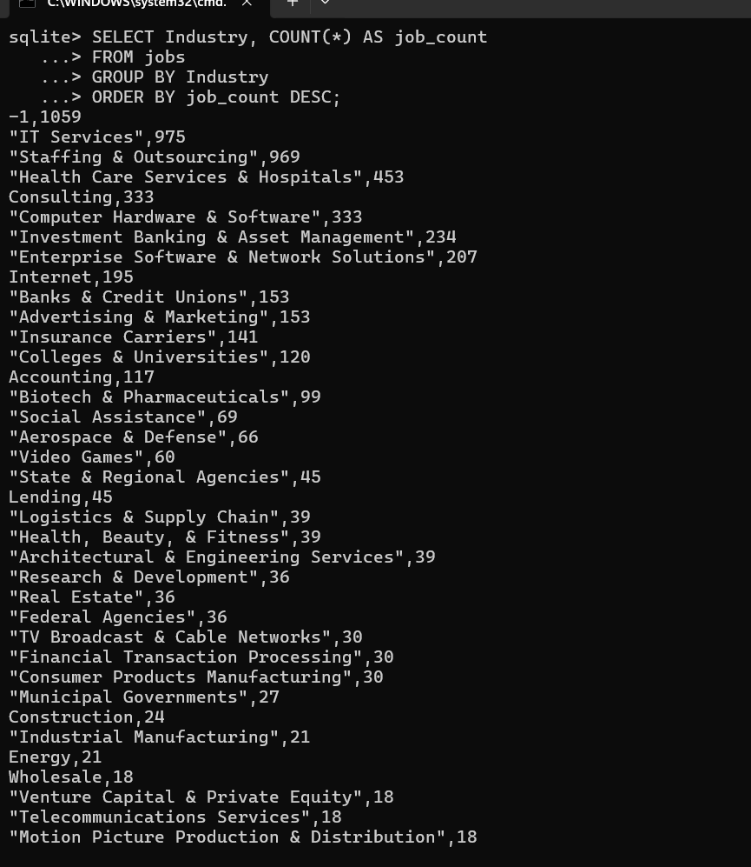
✅ Count jobs by industry

Slide 14
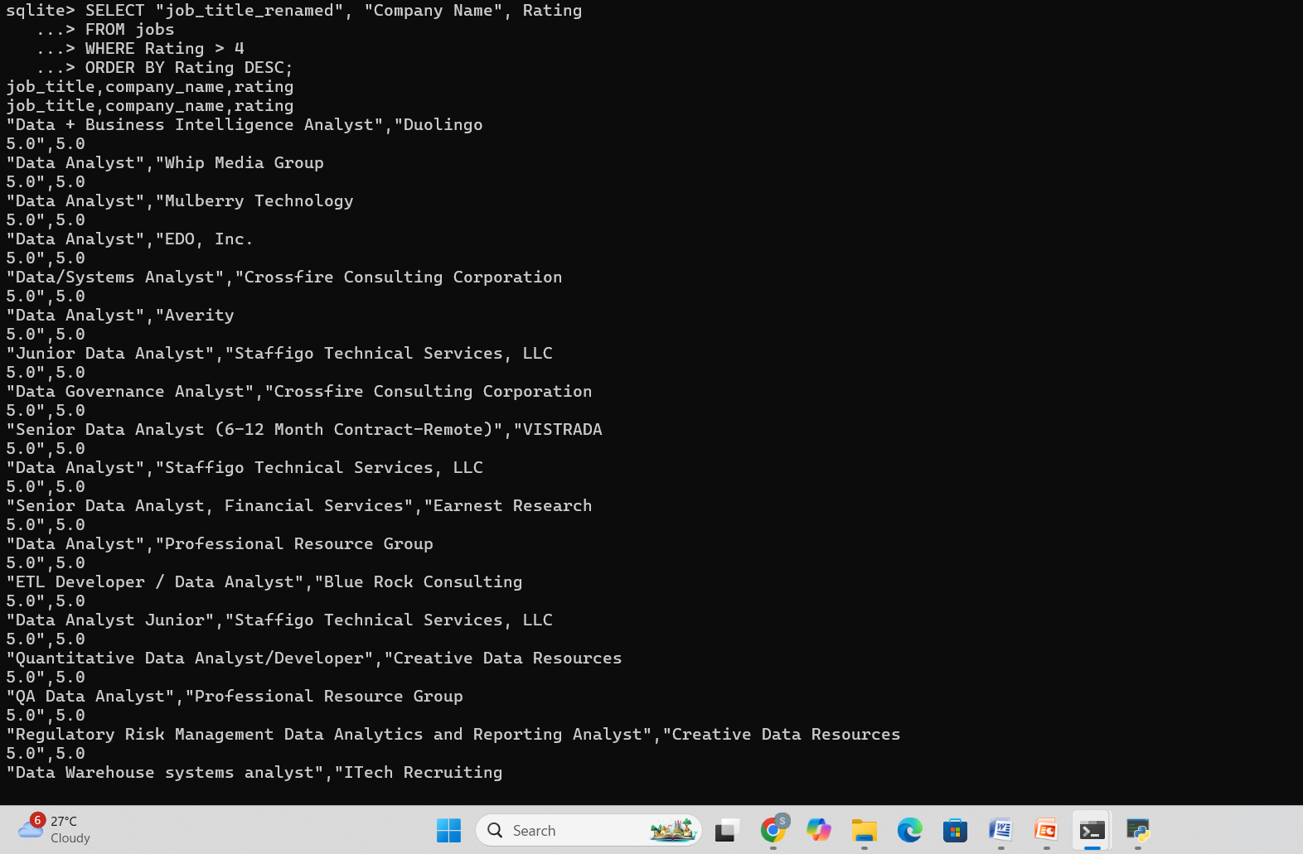
✅ Filter jobs based on company rating

Slide 15
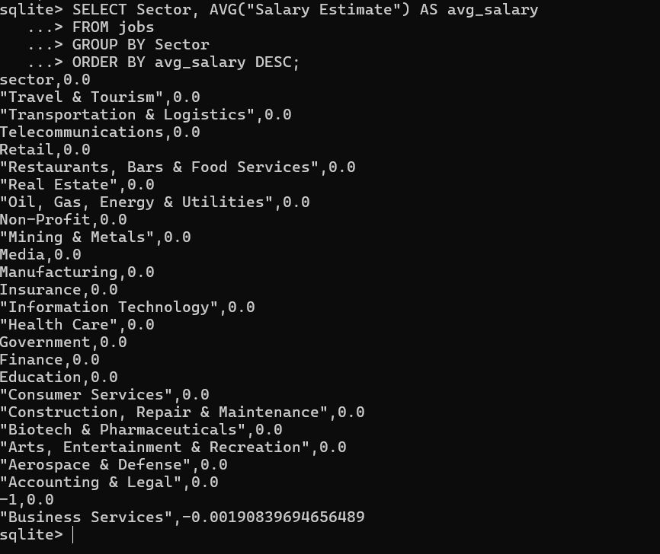
✅ Average salary by sector

Slide 16
Final Deliverables
📌 Cleaned Data: Missing values handled, salaries parsed
📌 EDA Insights: Top companies, job titles, salary trends
📌 Data Visualizations: Charts and graphs
📌 SQL Queries: Job trends & salary analysis

Slide 17
conclusion
✅ How the insights can help job seekers & companies ✅ Future improvements (e.g., more ML models, real-time data)

Slide 18
Thank you !!!

